Slide 1

TEAM SUNSHINE!
Cara, Carson, Brian, Richard

Slide 2
Benefits of solar prediction
At scale, this capability can help utilities plan their demand and consumers to plan their consumption
At the consumer level, this could help consumers keep their daytime usage within their generation capacity – important during peak times in the new net metering program mandated by the state

Slide 3
Scope
Goals
Use RESTful APIs to gather data from 2 data sources
Coalesce data and calculate 1 day prediction
Build Bootstrap UI to present data in tabular and graphics formats
Non-goals
Prediction beyond one day in advance
Perfecting of prediction

Slide 4
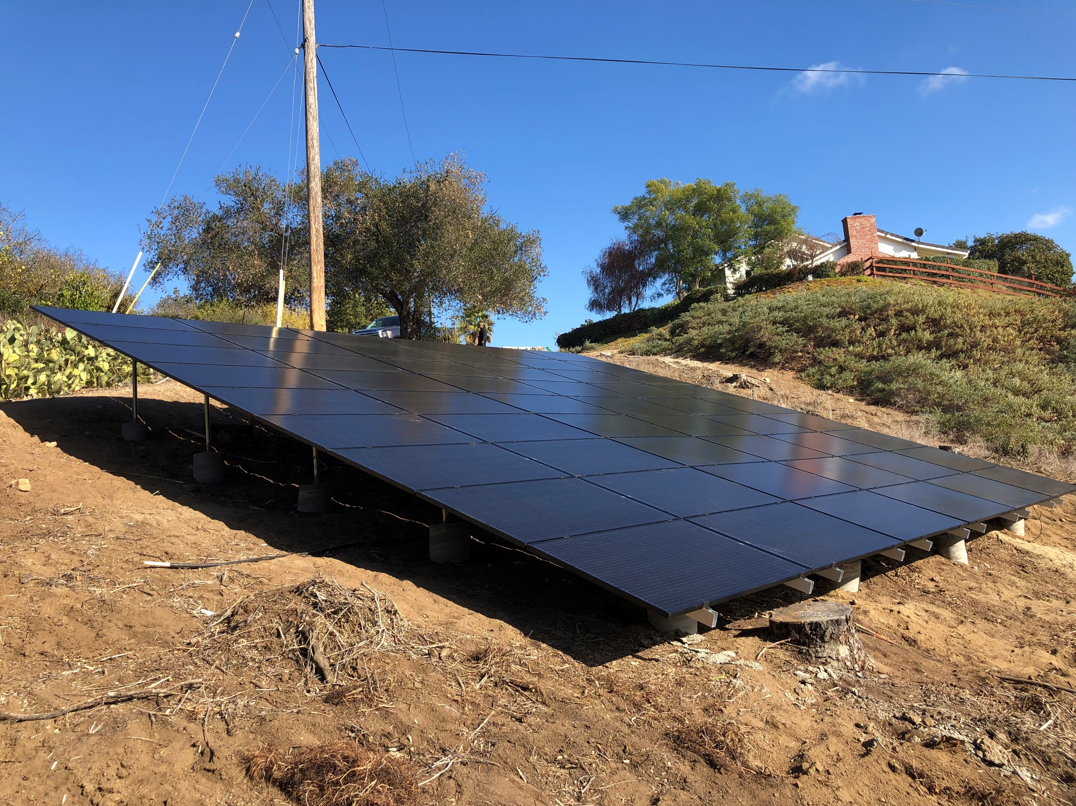
Data Sources
Solar Edge API
Provides power generation data
Weather API
Provides historical data and fore
Predictions
Custom Javascript by Carson using historical data and weather forecasts

Slide 5
Ui demo
Switch to browser

Slide 6
How we developed it
Divided the work by technology
UI : Brian
Prediction : Carson
Weather data interface : Cara
Solar data interface : Richard
Weather and Solar modules included callbacks for UI and Prediction to use to populate elements

Slide 7
Weather api

Slide 8
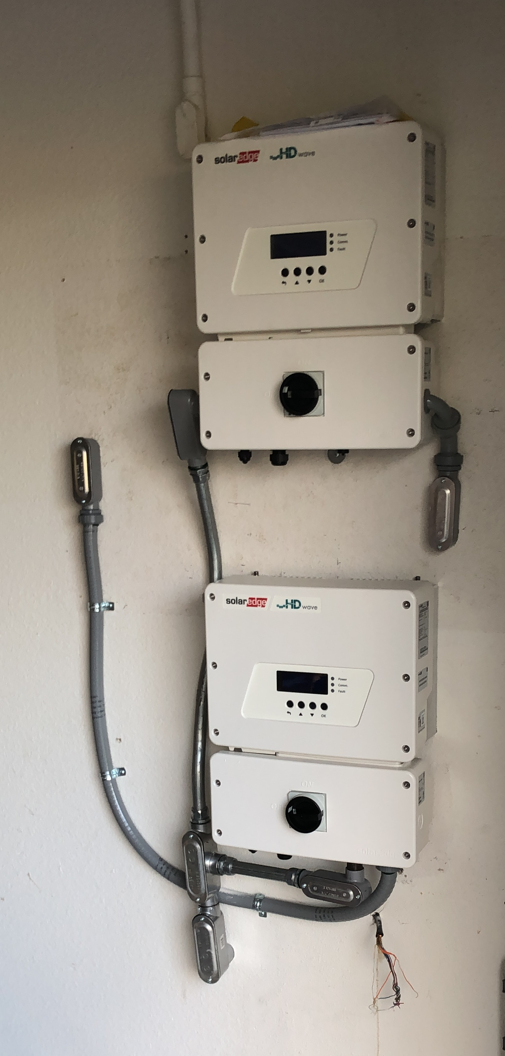
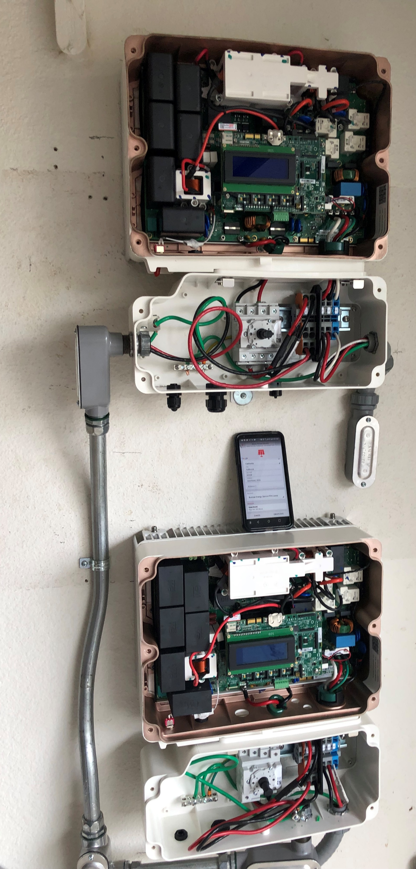
Power generation api
Solar Edge API
The Inverters are connected to the internet and update a cloud service every 15 minutes
API key was issued by Solar Edge to access data generated by these inverters
Using two APIs from Solar Edge:
Get site information (physical address of array)
Get site power generation history
Our interface module defines two Javascript functions:
function getSiteInfo(siteID, callback);
function getProductionHistory(siteID, startDateUnix, endDateUnix , callback)
Callback passes back a results object array

Slide 9
Prediction algorithm

Slide 10
New technologies used
SolarEdge API
Weather API – Darksky.net
Google Charts

Slide 11

TEAM WORK

Slide 12
Future development
Store past predictions on Firebase and include in graph
“what we predicted vs what actually happened”
Research time series analysis to improve predictions and to go further into the future

